Slide 1


MUSIC STORE DATA ANALYSIS
By Mukundraj Pawar
BATCH NO: 543_546

Slide 2
About me
Educational Background -- Btech/BE(CSE)
Pursuing Data Science to build data-driven applications and refine analytical skills.
3 years experience on non-technical work
Linkedin Profile
- www.linkedin.com/in/mukundraj-pawar-7a39a7364
Github profile
- https://github.com/teachmeiamyourjuniour/SQL-projects

Slide 3
Agenda:
Business Problem:
Business Statement:
Introduction
Objective of the Project
Data description
Key analysis questions (use cases)
Conclusion (Key finding overall)
Business Insights
Challenges

Slide 4
Business Problem:
The music store maintains a large transactional database of customers, invoices, tracks, artists, and genres but the data is not being converted into actionable business intelligence.
Without systematic analysis, the store cannot identify its highest-value customers, top-revenue cities, country-level genre preferences, or the artists driving the most sales.
Marketing campaigns are run broadly rather than targeted to specific cities, genres, or customer segments.
Promotional events (such as the planned Music Festival) cannot be placed in the highest-potential location without a clear revenue-by-city view.

Slide 5
Business Statement:
To leverage SQL-based data analysis to extract actionable business insights from the music store database, enabling data-driven decisions across customer engagement, promotional planning, inventory management, and revenue optimization.

Slide 6
Introduction:
Music store data is essential for understanding customer behavior, revenue trends, and genre preferences. This project uses MySQL to analyze customer, invoice, track, artist, and genre data from the music store database to generate meaningful business insights.
Using SQL queries, the project identifies top customers, highest-revenue cities, popular genres, and country-level spending patterns. The insights support data-driven decision-making and demonstrate the use of SQL for retail analytics and business reporting.

Slide 7
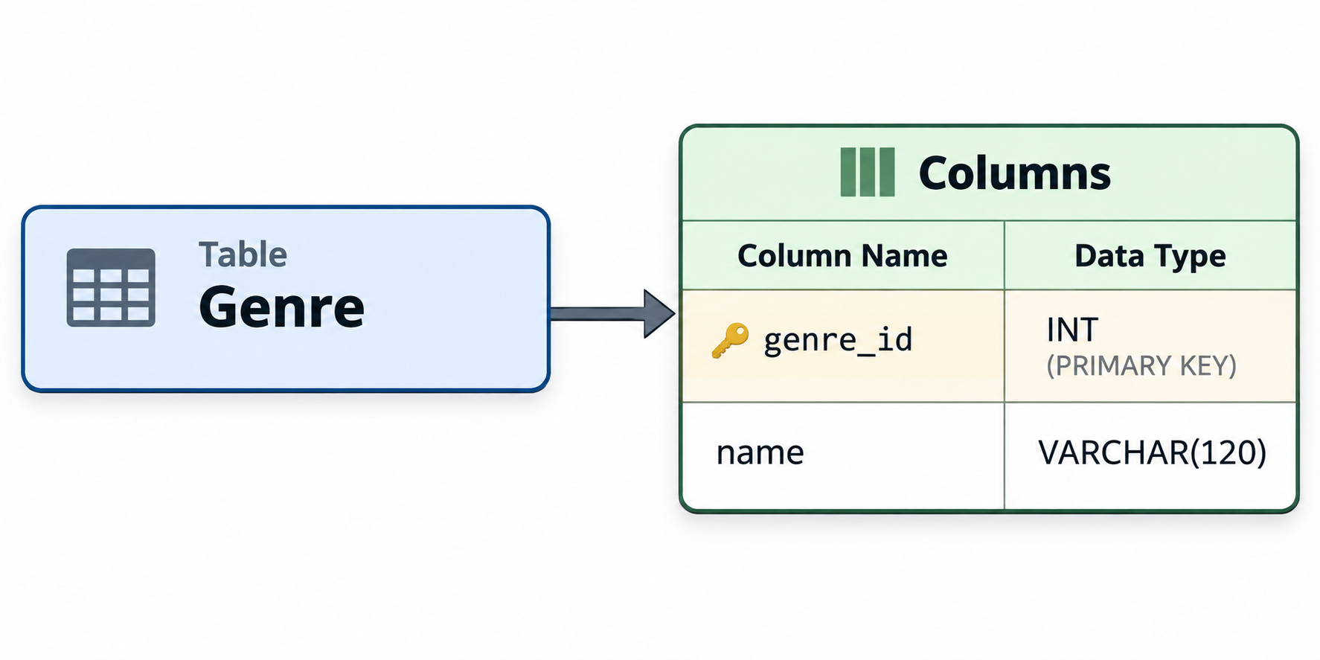
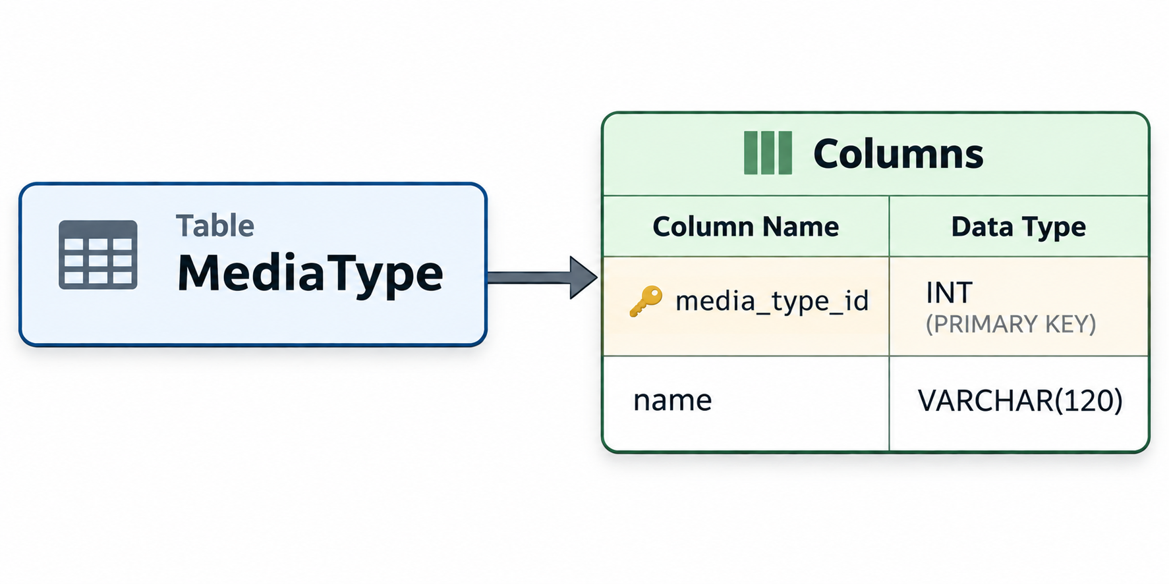
DATA DESCRIPTION

Slide 8
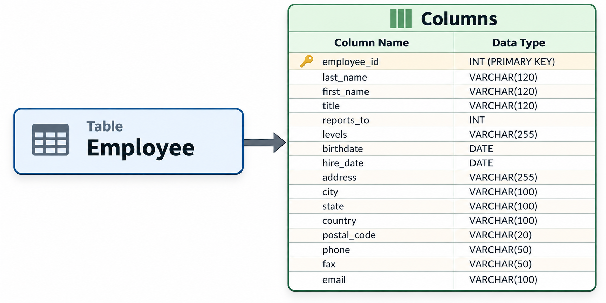

Slide 9
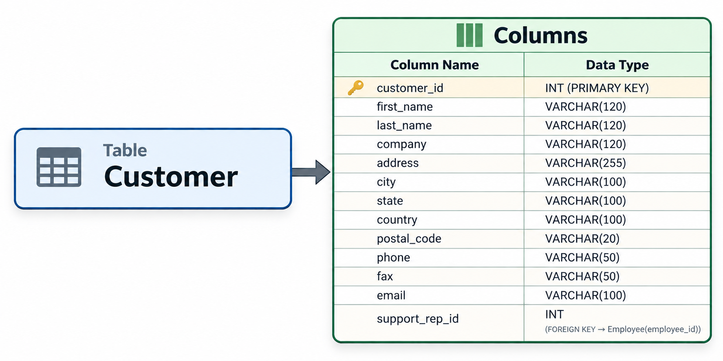

Slide 10
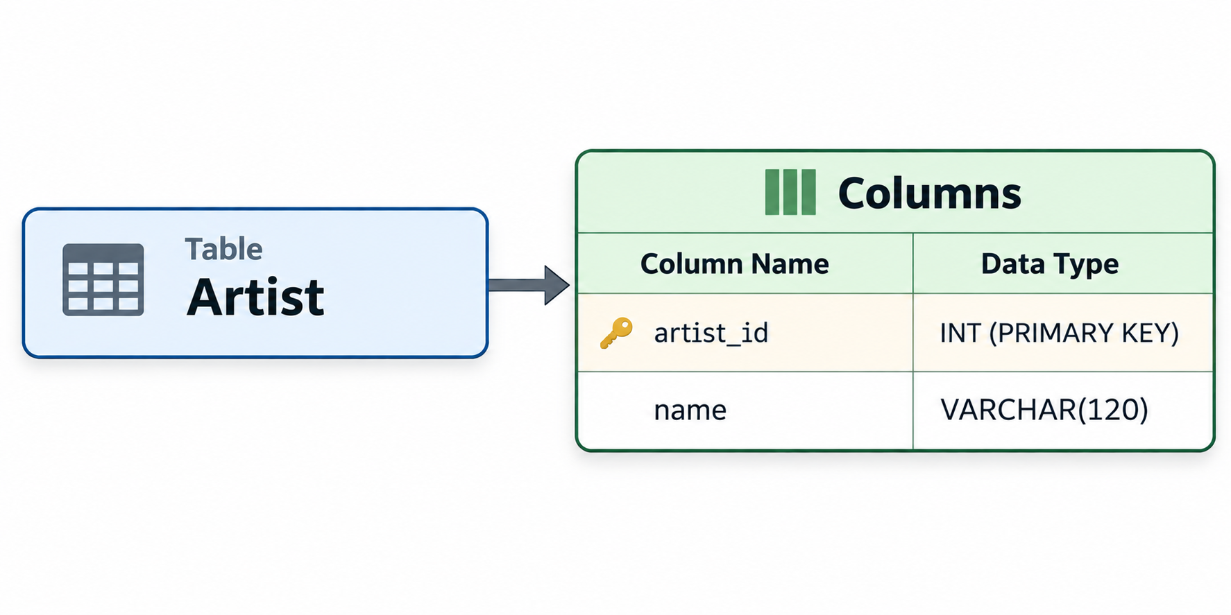
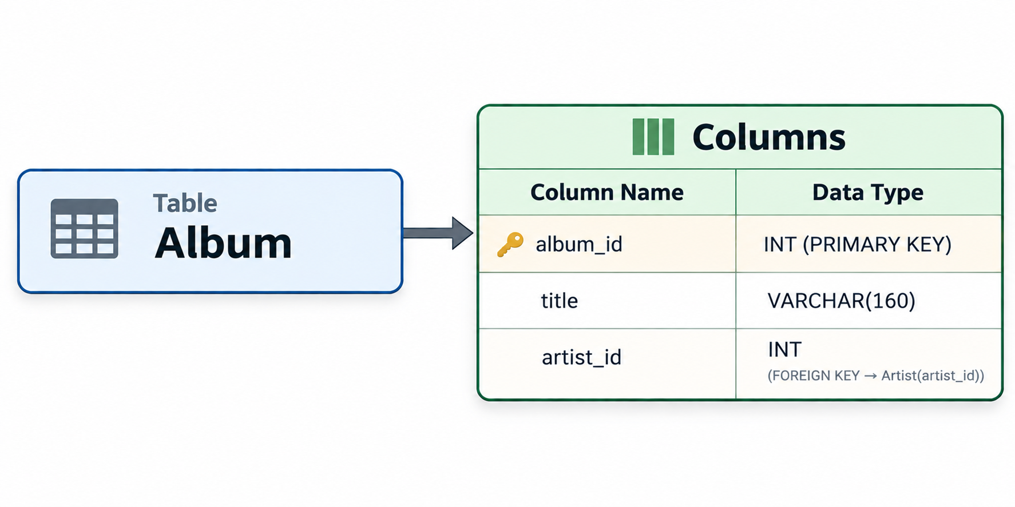

Slide 11
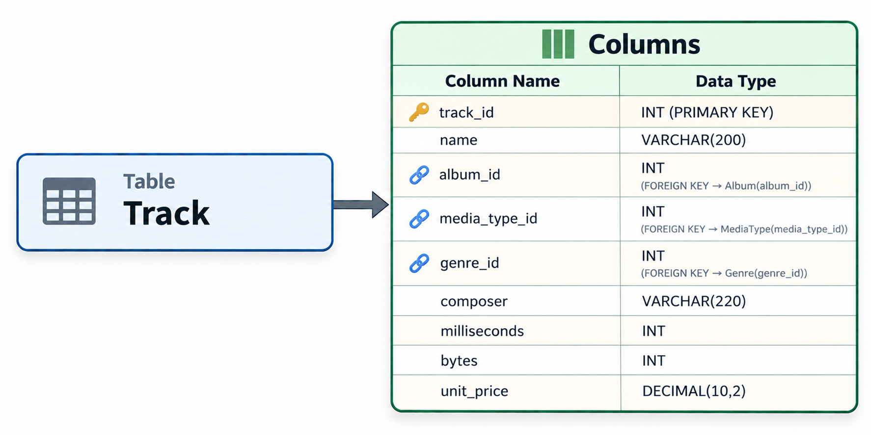

Slide 12
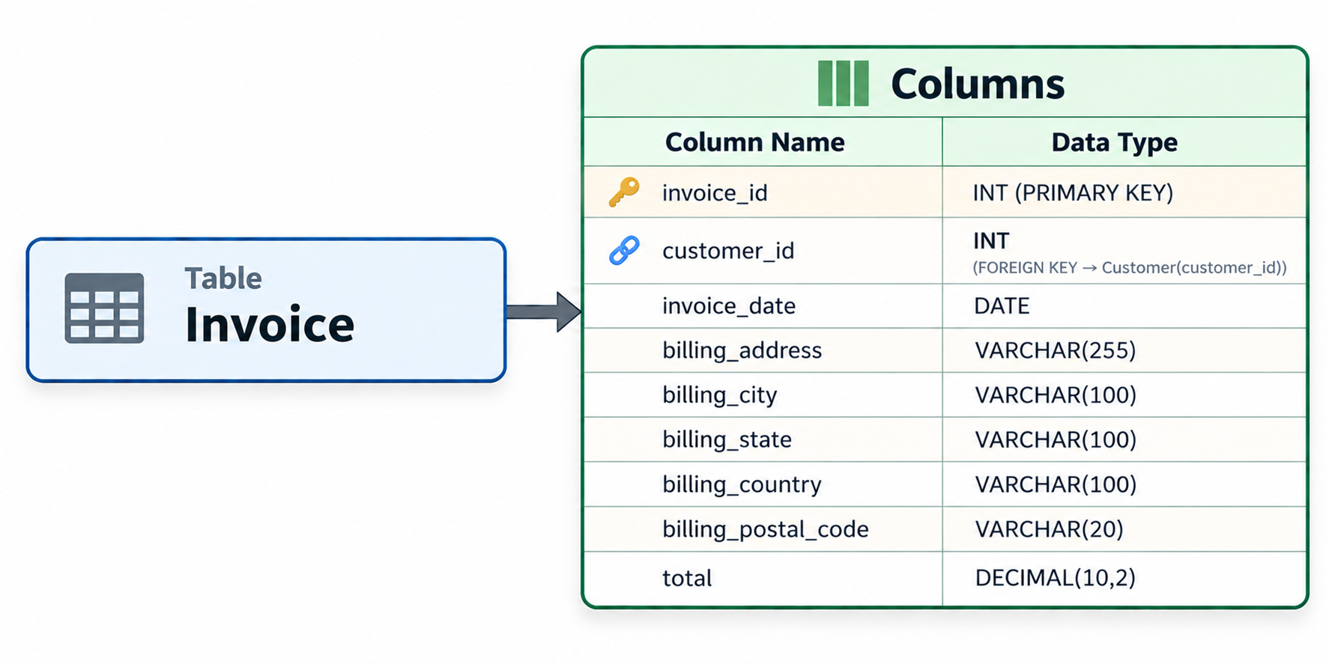

Slide 13
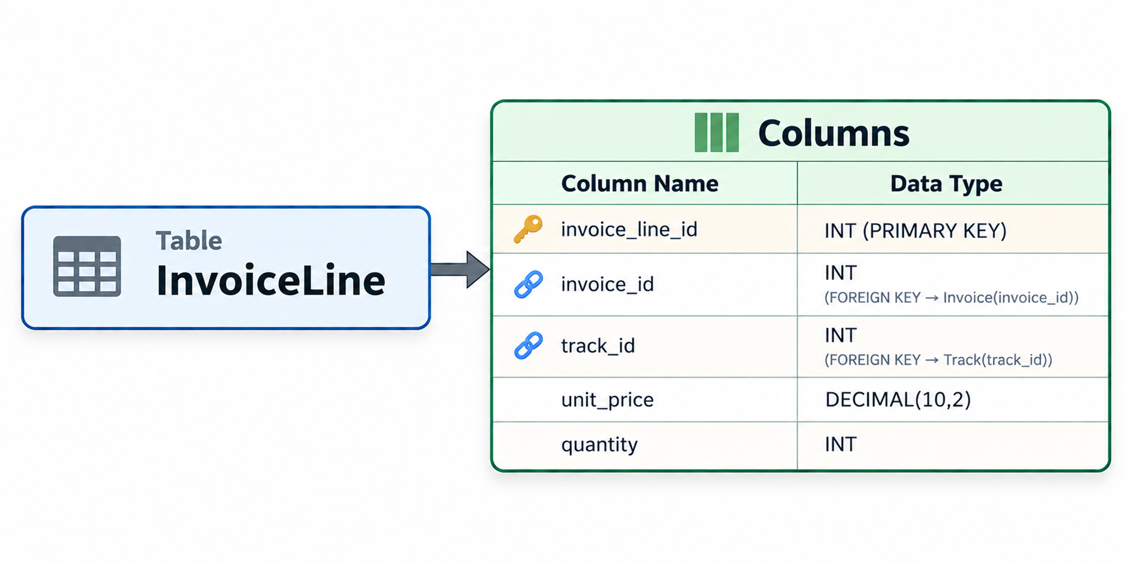
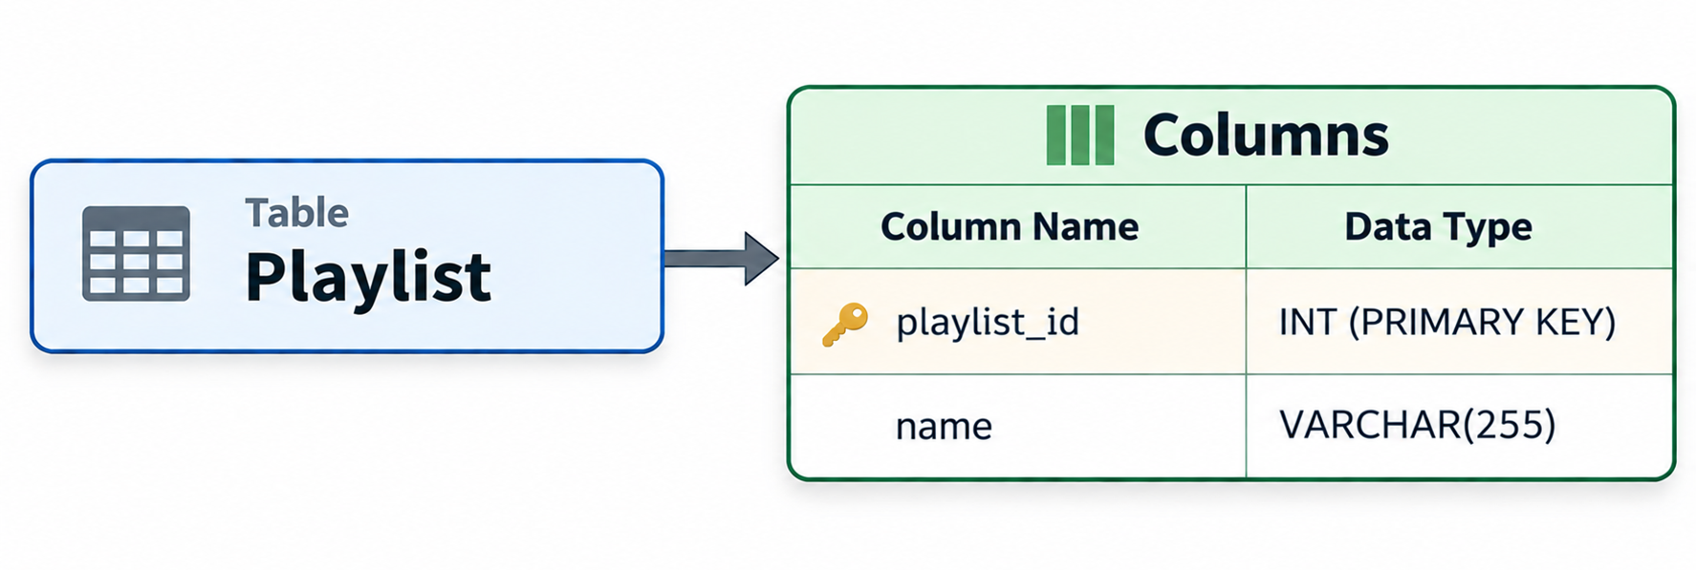

Slide 14
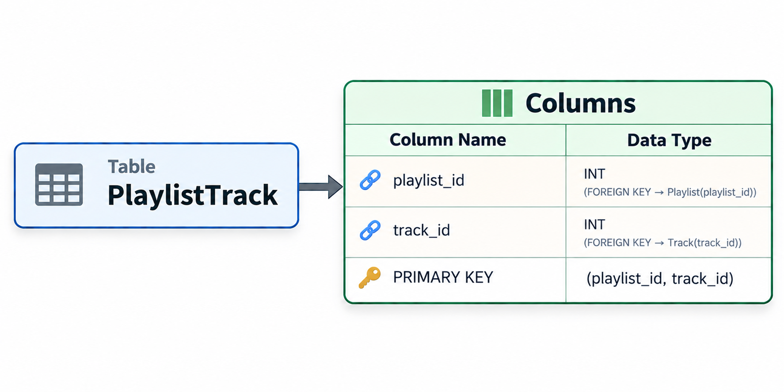

Slide 15
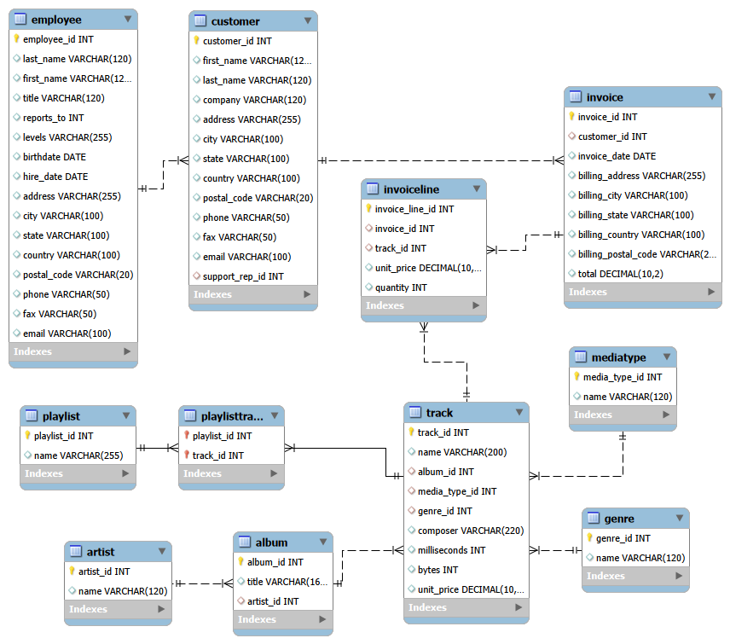
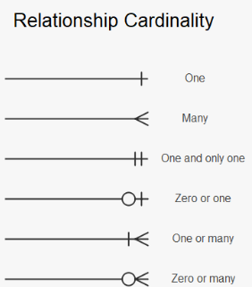
ER Diagram:

Slide 16
Objective of the Project:
To analyze music store data using MySQL and generate meaningful business insights.
To examine customer distribution, revenue patterns, and genre preferences across regions.
To analyze invoice and sales data for effective revenue planning.
To identify top customers, popular artists, and trending genres.
To evaluate country-level trends and their impact on revenue.
To use SQL queries for data extraction, aggregation, and reporting.

Slide 17


Key Analytical Queries
1.Who is the senior-most employee based on job title?
Output:
Key Insight:
This analysis helps identify the top-most employee in the hierarchy the one with no manager (reports_to IS NULL). It clarifies the leadership structure of the music store and supports reporting, payroll, and succession planning.

Slide 18
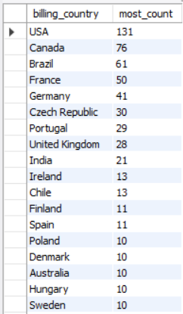
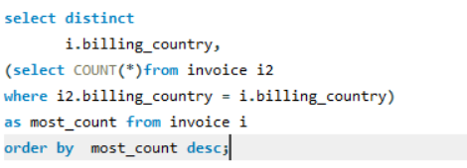
2.Which countries have the most Invoices?
Output:
Key Insight:
The USA leads with the highest number of invoices, followed by other key markets. This geographic concentration helps prioritize regional marketing, allocate inventory, and design country-specific promotional campaigns for maximum ROI.

Slide 19
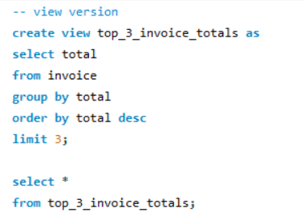

3.What are the top 3 values of total invoice?
Output:
Key Insight:
The top 3 invoice totals reveal the ceiling of single-transaction spending. These outliers indicate premium or bulk purchases and help benchmark pricing strategy, identify high-value transactions, and define loyalty thresholds for VIP customers.

Slide 20
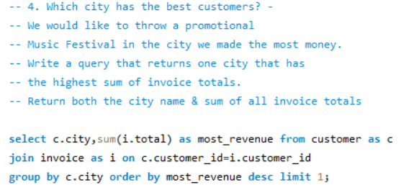
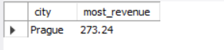
4.Which city has the best customers?
Output:
Key Insight:
We would like to throw a promotional Music Festival in the city that has made the most money. The top-earning city represents the strongest market for a promotional Music Festival, ensuring maximum footfall and return on event investment. The result also serves as a model for replicating similar events in other high-revenue locations.

Slide 21
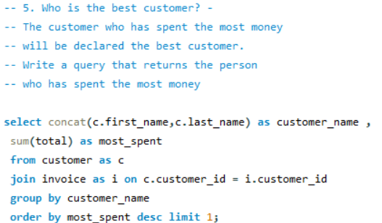
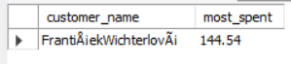
5.Who is the best customer?
Output:
Key Insight:
The customer who has spent the most money is a high-value asset worth retaining through VIP treatment, exclusive offers, and personalized engagement. Recognizing and rewarding this customer drives word-of-mouth referrals and long-term loyalty.

Slide 22
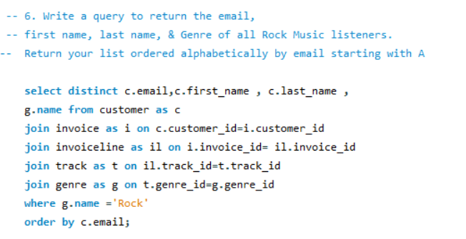
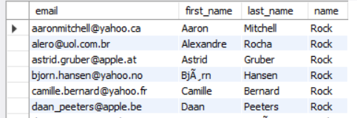
6.Write a query to return the email, first name, last name, & Genre of all Rock Music listeners. Return the list ordered alphabetically by email starting with A.
Output:
Key Insight:
This filtered contact list of Rock music listeners is the foundation for targeted Rock-focused email marketing, new-release announcements, and concert promotions. Sorted alphabetically by email, it integrates directly into CRM tools for segmented campaign execution.

Slide 23
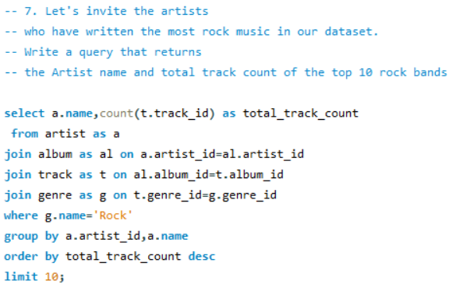
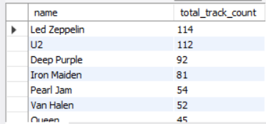
7. Let's invite the artists who have written the most Rock music in our dataset. Write a query that returns the Artist name and total track count of the top 10 Rock bands.
Output:
Key Insight:
The top 10 Rock artists by track count are prime candidates for promotional events, partnerships, and featured playlists. Their large catalog footprint indicates strong catalog demand and reliable audience engagement for Rock enthusiasts.

Slide 24
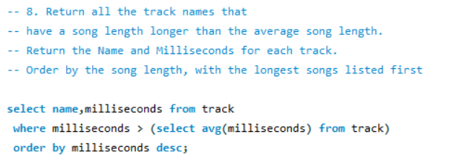
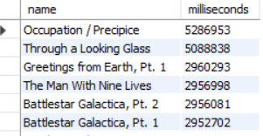
8.Return all the track names that have a song length longer than the average song length. Return the Name and Milliseconds for each track. Order by the song length, with the longest songs listed first.
Output:
Key Insight:
Tracks above the average duration are typically longer, more artistic compositions (e.g. progressive rock, classical, jazz). These are ideal for curated playlists, deep-listening recommendations, and identifying premium catalog content that commands higher engagement time.

Slide 25
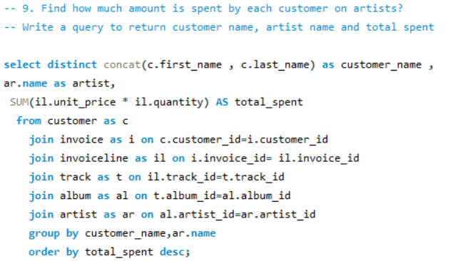
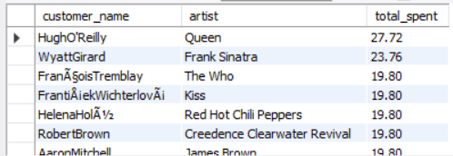
9. Find how much amount is spent by each customer on artists. Write a query to return customer name, artist name and total spent.
Output:
Key Insight:
This customer-artist spending analysis which artists generate the most revenue from each customer. It enables personalized recommendations, targeted promotions for under-discovered artists in a customer's library, and helps forecast demand for new releases by specific artists.

Slide 26
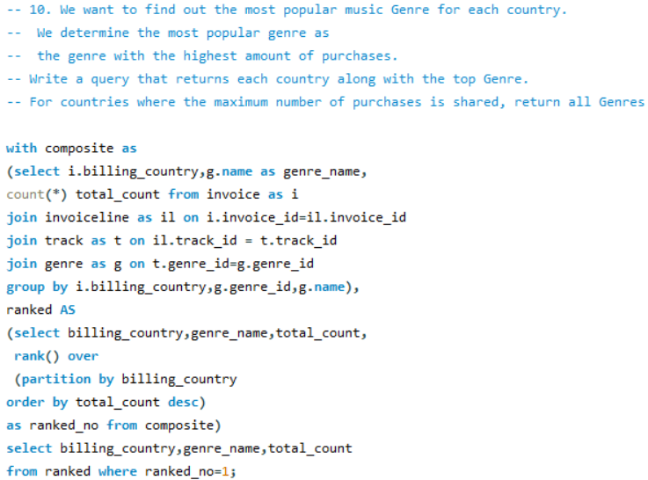
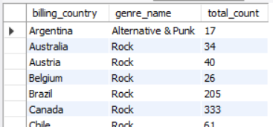
10. We want to find out the most popular music Genre for each country. We determine the most popular genre as the genre with the highest amount of purchases. Write a query that returns each country along with the top Genre. For countries where the maximum number of purchases is shared, return all Genres.
Output:
Key Insight:
Genre preference varies significantly by country. Identifying the top genre per market enables localized inventory planning, region-specific marketing campaigns, and licensing decisions aligned with local listening behavior.

Slide 27
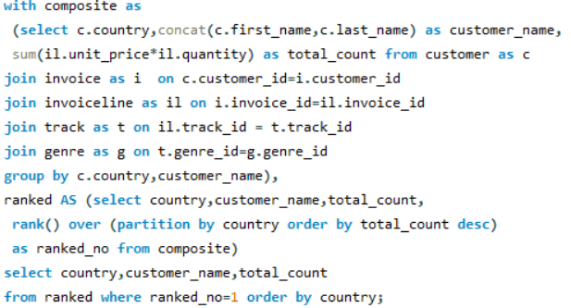
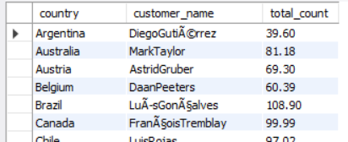
11.Write a query that determines the customer that has spent the most on music for each country. Write a query that returns the country along with the top customer and how much they spent. For countries where the top amount spent is shared, provide all customers who spent this amount.
Output:
Key Insight:
Top customers by country are anchors for territory-specific loyalty programs, regional VIP clubs, and localized referral campaigns. Identifying them allows targeted retention strategies and stronger commercial presence in each market.

Slide 28
Conclusion:
This project successfully analyzed the music store database using SQL to generate meaningful business insights related to customer behavior, revenue trends, genre preferences, and country-level spending patterns.
Through data extraction, multi-table joins, aggregations, CTEs, and window functions, the project demonstrated how SQL transforms raw transactional data into actionable information that supports marketing analytics, business intelligence, and data-driven decision-making.

Slide 29
Future Enhancements:
Integrate a real-time analytics dashboard (Power BI / Tableau / Looker) on top of the SQL database to visualize sales, customer, and genre trends interactively.
Apply machine learning models for customer churn prediction, lifetime value forecasting, and personalized music recommendations.
Build a customer segmentation model (e.g. RFM analysis) to enable tiered loyalty programs and targeted marketing campaigns.
Add geographic visualizations (heat maps, choropleths) to compare revenue, genre preference, and customer density across countries and cities.

Slide 30
Challenges:
Designing a relational schema with proper primary and foreign key relationships across 11 tables.
Importing large CSV files (track.csv, invoice_line.csv, playlist_track.csv) without errors.
Ensuring data consistency and applying CASCADE constraints for foreign keys.
Writing complex multi-table JOINs to combine customer, invoice, track, and artist data.
Using window functions (RANK OVER PARTITION BY) for country-level genre and customer rankings.
Handling duplicate or tied values in ranking queries -- returning all customers with shared max spend.
Translating real-world business questions into efficient SQL logic.
Optimizing queries for large datasets to keep report generation fast.

Slide 31


Slide 32
THANK YOU

